Slide 1
Software Engineering
Chapter 6: Software Design
Unified Modelling Language
Class Diagrams
Learning Outcomes
  Be able to identify classes from a problem description
  Be able to create class diagrams from a description of a problem
  Understand and be able to apply the constructs of a class diagrams
Text: Priestley Chapter 8
Bruegge & Dutoit, Chapter 5

Slide 2
Objects
Object = an item that has a hidden internal structure. This hidden structure is manipulated or accessed by messages (e.g. method calls) sent by a user programmer to the object
Message = request sent to an object to obey one of its hidden methods
Method = an action that manipulates or accesses the internal state of the object. The implementation of this action is hidden from a programmer who sends messages to this object
Instance Variable = The data that represents the internal state of the object (properties/attributes)
Class = A class is a set of objects that share common attributes and behaviour.

Slide 3
An Analogy
We want to fix the car
  Select an appropriate object (a mechanic) and pass them a message containing our request
  It is now the mechanic’s responsibility to carry out this task
  The mechanic uses some method to carry out the task - details of the method are not known to the customer
    implementation details of the method are hidden
    the method may involve the mechanic object passing messages to other objects
    the interpretation of the message is dependent on the receiver object (polymorphism)
In essence:
  Procedural programming - do something to something else
  OO Programming - tell something to complete a task it has responsibility for

Slide 4
Classes and Instances
We can make assumptions about the behaviour of objects based on their position within the universe
  Our mechanic (say, Bill) is one instance of the general category (class) of Mechanics
  We expect Bill to follow the general pattern of Mechanics
All objects are instances of a class
  The method invoked by an object in response to a message is determined by the class of the receiver.
  All objects of a given class have the same general attributes or instance variables
  All objects of a given class use the same method in response to similar messages

Slide 5
Class, Object, Message, Method
Writing a class
class Account{
instance variables here
methods here
}
Account
balance
min_balance
deposit
withdraw
account_balance
set_min_balance
instance variables
methods
construct new instance
Declaring an object
Account fred = new Account();
Sending a message
fred.deposit(100.00);
declaration
object
message
parameter

Slide 6
A sample class
class Account
{ private double balance = 0.0;
private double min_balance = 0.0;
public Account()
{ balance= min_balance = 0.0; }
public void deposit(final double amount)
{balance = balance + amount;}
public double withdraw(final double amount)
{if ( (balance - amount) >= min_balance)
{ balance = balance - amount;
return amount;
}
else
{ return 0.00;
}
}
public void set_min_balance (final double min_balance_value)
{min_balance = min_balance_value; }
public double account_balance ()
{return balance;}
}

Slide 7
Attributes in UML
Shown in middle compartment of the Class
Underline indicates class scope i.e just one variable for all instances i.e. In Java, a static variable
Module
- mcount: integer
- code
- title: String
- credits: integer=15
- exDate [0..1]: Date
staff[1..*] : String
Leave out the type (in this case, of the module code), if the type is not yet known
Initial value can be stated
“-” indicates private
What do you think 0..1 indicates?
[1..*] indicates one or more
What might this be in Java?

Slide 8
Attributes in UML
Shown in middle compartment of the Class
Underline indicates class scope i.e just one variable for all instances i.e. In Java, a static variable
Module
- mcount: integer
- code
- title: String
- credits: integer=15
- exDate [0..1]: Date
staff[1..*] : String
Leave out the type (in this case, of the module code), if the type is not yet known
Initial value can be stated
“-” indicates private
[0..1] indicates optional attribute
[1..*] indicates one or more:
in java you could use an array

Slide 9
Operations...
...go in bottom compartment
...also called: methods, behaviour, services
What is the “behaviour” of an object?
  Behaviour refers to those things that the object can do
    corresponds to functions that act on the object’s data (or attributes)
  An object is solely responsible for carrying out any functions or behaviours that act upon its own data (or attributes)
Module
-mcount: integer
-code
-title: String
-credits: integer=15
-exDate [0..1]: Date
-staff[1..*] : String
Class scope
+Module(code)
+getCount(): integer
+getTitle(): String
+setTitle(t: String)
+enrol(s: Student)
Instance scope

Slide 10
Visibility
Attributes and Operations have different visibility
In UML
  “+” = public
  “-” = private
  “#’ = protected
  “~” = package
Access levels
Modifier | Class | Pack -age | Sub-class | World
public | Y | Y | Y | Y
protected | Y | Y | Y | N
no modifier | Y | Y | N | N
private | Y | N | N | N
+
#
-
Source: Oracle

Slide 11
Class associations
An association is a relationship that exists between one or more objects/classes.
  For example, consider the object classes customer and order
  a CUSTOMER PLACES zero or more ORDERs
    an ORDER IS PLACED BY one and only one CUSTOMER
We graphically illustrate the association(relationship) between two classes as a connecting line.
  Verb phrases describe the relationship.
  Multiplicity defines the minimum and maximum number of occurrences of one object/class for a single occurrence of the related object/class.
  Multiplicity can be defined at both ends of every relationship.
1
Places
0..*
Customer
Order

Slide 12
Multiplicity - examples
1
Class name
means one and only one
* or
0..*
Class name
means zero or more
0..1
Class name
means zero or one
1..*
Class name
one or more
1..4
Class name
one min to four max

Slide 13
Associations – labels, roles & navigability
1..*
teaches►
0..*
Lecturer
Course
◄Is taken by
If it helps, you can specify the direction the association should be read in.
Role played by instances
employee
employer
Person
Company
*
WorksFor►
1
Arrow indicates association is in only 1 direction – this means that Company objects will send messages to Person objects but Person objects cannot send messages to Company objects

Slide 14
Association Classes
A class may be attached to an association rather than directly to another class.
Such a class is called an Association Class. It can have data attributes and behaviour just like any other class
Used to hold information on each occurrence of a relationship
*
Supplies►
*
Supplier
Part
Contract
Date

Slide 15
Association Classes - Another Example
1..*
Is taking
6
Student
Module
Mark
mark: integer

Slide 16
Qualified Associations
1
*
University
Student
id: integer
name: String
We can’t we tell from this that id is unique to the student in his/her dealings with the university.
Solution – qualified association:
1
0..1
University
id: integer
Student
id: integer
name: String

Slide 17
Inheritance
Inheritance implies that methods and/or attributes defined in a class can be inherited or reused by another class.
... also referred to as generalisation and specialisation.
  Generalisation/specialisation
    attributes and behaviours that are common to several types of classes are grouped into their own class, as a generalisation
    The subtypes of the generalised class are called specialisations

Slide 18
The case for inheritance
Let’s say we have an account class…
Suppose we want another version of Account that supplies a bank statement
Account
balance
min_balance
deposit
withdraw
account_balance
set_min_balance
AccountPlus
balance
min_balance
statementNumber
deposit
withdraw
account_balance
set_min_balance
statement
One solution
  Create another class, this time with the additional member variables and methods

Slide 19
Problems with just copying an old class…
Q: What’s wrong with this?
A:

Slide 20
Problems with just copying an old class
Q: What’s wrong with this?
A:
  The code from Account must be re-tested
  Errors may be introduced during the copying
  Changes could become inconsistent later
  …

Slide 21
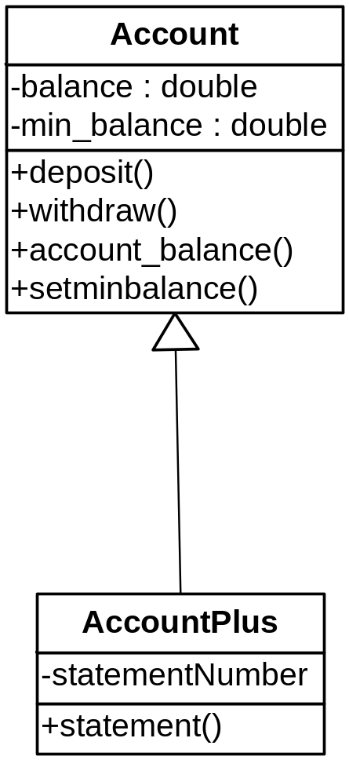
Inheritance illustrated
Account is composed of
  the instance variables: balance and min_balance
  the methods: deposit, withdraw, account_balance, set_min_balance
AccountPlus uses
  All of the instance variables of Account
  Plus: statement_no and account_name
  All of the methods of Account
  Plus: the method statement()
AccountPlus
-statement_no
-account_name
+statement()

Slide 22
Inheritance Implemented
class AccountPlus extends Account
{ private String account_name = "";
private long statement_no = 1;
public AccountPlus()
{ account_name = "Anonymous";
statement_no = 1;
}
public AccountPlus( final String name )
{ account_name = name;
statement_no = 1;
}
public String statement()
{return "Mini-statement #" + statement_no++ +
" for " + account_name + "\n" +
"The balance of your account is : £" + account_balance() + "\n";
}
}

Slide 23
Subclassing for Specialisation
The most common view of inheritance (subtyping)
  the new class is a specialised form of the parent but satisfies the specifications of the parent in all respects
  Example: a class Window provides general window manipulation operations (move, resize, maximise, minimise, etc). A subclass TextEditWindow inherits these, but adds facilities to allow the user to display and edit text information
  Exhibits (the desirable) principle of substitutability
    Window can be replaced by TextEditWindow in all instances

Slide 24
Subclassing for Generalisation
The child modifies or overrides some of the behavior provided by the parent
  opposite of subclassing for specialisation
  By overriding some functionality of the parent, the child becomes more specialised, and makes the parent more generalised
  Example: a graphics system where class Window is provided:
    We might create a subclass ColouredWindow which adds a Colour field and overrides the inherited code to allow the background to be drawn in that colour

Slide 25
Subclassing for Extension
The child class adds new functionality without changing any inherited behaviour
  whereas generalisation modifies (overrides) existing capabilities, extension simply adds new methods to create a subclass that extends the parent’s functionality into a quite new application area.
    A form of specialisation, but with a significant new purpose
  Example: a StringSet class which inherits from a Set class but includes additional string-related operations such as searchByPrefix or searchBySubstring which are not relevant to the parent class
  as the functionality of the parent remains available and untouched, the principle of substitutability holds true

Slide 26
Subclassing for Variance
The child and parent exhibit an arbitrary hierarchical relationship
  two classes with similar implementations: one can be created from the other; which way round is unimportant (the hierarchical relationship is therefore arbitrary)
  Example: the code to control a mouse is nearly identical to that required for a graphics tablet
    select one to be the parent with the common code inherited by the other and device-specific code being overridden

Slide 27
Subclassing for Specification
Guarantee that a common interface is maintained
  the parent and child classes implement the same methods:
  the parent can be a combination of implemented operations and operations that are deferred to the child classes
  special case of subclassing for specialisation except that subclasses are not just subtypes, but realisations of an incomplete abstract specification
  Example - in a pool table simulation classes Ball, Cushion and Pocket are subclasses of GraphicalObject. They all provide realisations for methods HitByBall and Draw

Slide 28
Benefits of Inheritance (1)
In practice many of the following aspects of inheritance will be closely interwoven
Software Reusability
  no need to rewrite code that can be inherited, hence greater reliability and decreased maintenance cost
Code Sharing
  many users/projects can share the same class
  multiple classes developed by the same programmer can inherit from a single class (e.g. set & array from collection)

Slide 29
Benefits of Inheritance (2)
Consistency of Interface
  when multiple classes inherit from the same superclass, we can assume that the behaviour they inherit will be the same in all cases
    can provide handy way of accessing and/or adapting existing funcntionality (see above points also)
Software Components
  development and availability of class libraries
Rapid Prototyping
  when constructed from reusable components, initial impementations can be developed more quickly

Slide 30
Benefits of Inheritance (3)
Information Hiding
  a programmer who reuses a software component needs only to understand the nature of the content and its interface
Polymorphism
  (different objects respond to the same message in different ways)
  enables the programmer to generate high-level reusable components that can be tailored to fit different applications

Slide 31
The Costs of Inheritance (1)
Execution Speed
  inherited methods which must deal with arbitrary subclasses are often slower than specialised code
Coupling increased
  Where one module inherits from another there is coupling i.e. a dependency which reduces reusability of the module

Slide 32
The Costs of Inheritance (2)
Message-Passing Overhead
  message passing is normally (slightly) slower than traditional procedure calls
Reduced Program Understanding
  Overuse of inheritance can lead to the “yo-yo problem” - where several scans up and down the class hierarchy are required to understand the flow of control of a program
  Complex hierarchies (and complex architectures generally) may obscure the source of particular functionality – making that functionality more difficult to adapt and maintain

Slide 33
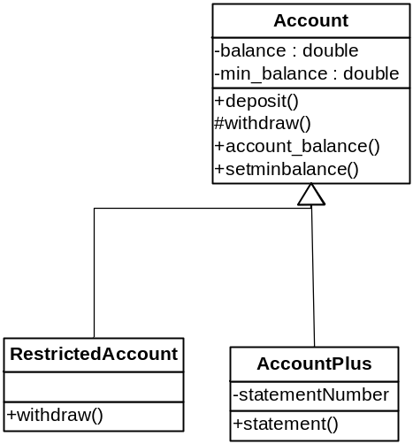
Overriding a superclass method
As well as inheriting methods from a superclass, a subclass can override a superclass method.
e.g. Restricted_Account = same as Account but only 3 withdrawals allowed per year
class Restricted_Account extends Account
{ private static final int MAX_WITHDRAWALS = 3;
private int num_withdrawals_left = 0;
public void reset()
{ num_withdrawals_left = MAX_WITHDRAWALS;
}
public double withdraw (final double amount)
{ if (num_withdrawals_left>0)
{ num_withdrawals_left = num_withdrawals_left - 1;
return super.withdraw(amount);
}
else return 0.0;
}
}
AccountPlus
-statement_no
-account_name
+statement()
Run the superclass method

Slide 34
Some rules about overriding
What if the method to override is private?
  E.g. private double withdraw(final double amount)
  Can’t do it!
What if it is protected?
  E.g. protected double withdraw(final double amount)
  May be overridden if the overriding method is protected or public
What if it is public
  E.g. public double withdraw(final double amount)
  Can be overridden if the overriding method
  is public
Access levels
Modifier | Class | Pack -age | Sub-class | World
public | Y | Y | Y | Y
protected | Y | Y | Y | N
no modifier | Y | Y | N | N
private | Y | N | N | N
+
#
-
Source: Oracle

Slide 35
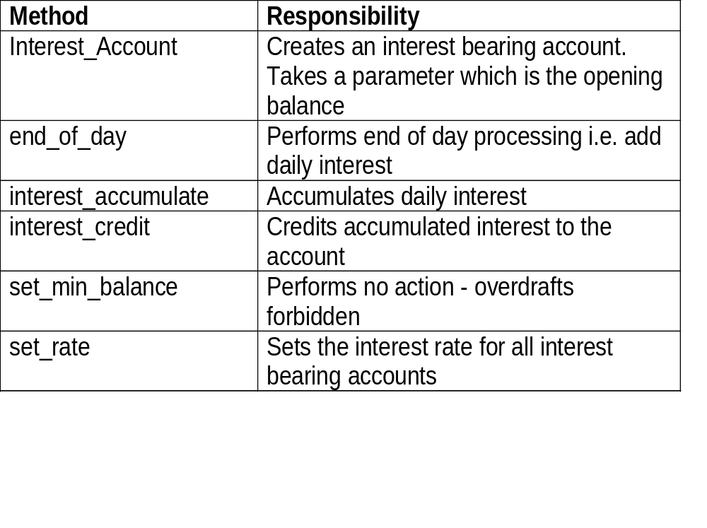
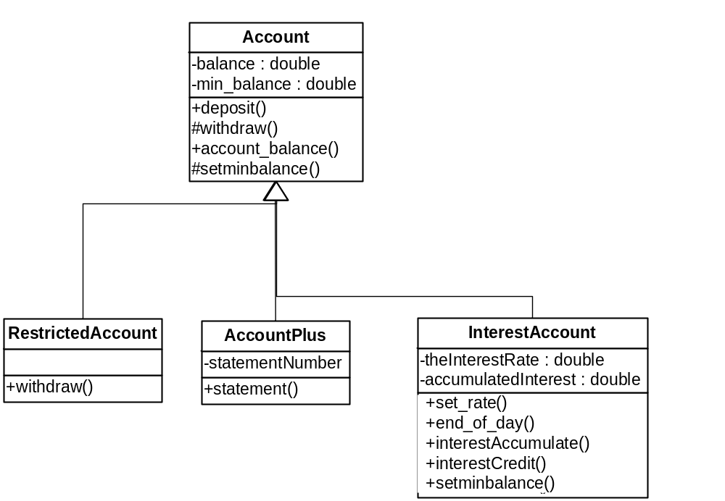
Case Study: Interest bearing Account
AccountPlus
-statement_no
-account_name
+statement()
Interest_Account
-the_interest_rate: double
-the_accumulated_interest
+set_rate()
+end_of_day()
#interest_accumulate()
+interest_credit()
+set_min_balance()

Slide 36
Interest bearing Account(2)
Additional useful class
  To keep the interest rate as a constant
    0.00026116 is a daily rate equivalent to a 10% annual rate
  Interest_Account
class IA_Const
{
public static final double RATE = 0.00026116;
}
class Interest_Account extends Account
{
private static double the_interest_rate = IA_Const.RATE;
private double the_accumulated_interest;
The same for all instances of Interest_Account

Slide 37
Interest bearing Account(3)
Constructors
But we might want to open an account with a deposit
public Interest_Account()
{ the_accumulated_interest = 0.0;
}
public Interest_Account(final double initial)
{ this(); //Constructor in this class
deposit( initial ); //Set initial amount
}
this = current object - this() has effect of calling the first constructor

Slide 38
Interest bearing Account(4)
We will want to be able to change the rate
At the end of each day the account has grown
accumulate the daily interest
public static void set_rate(final double ir)
{ the_interest_rate = ir;
}
public void end_of_day()
{ interest_accumulate(
account_balance() * the_interest_rate );
}
protected void interest_accumulate( final double ai )
{
the_accumulated_interest += ai;
}

Slide 39
Interest bearing Account(5)
Update the amount in the account
Interest-bearing accounts do not allow overdrafts
public void interest_credit()
{ deposit( the_accumulated_interest );
the_accumulated_interest = 0.0d;
}
public void set_min_balance( double money )
{ return; //deny access to superclass method
}

Slide 40
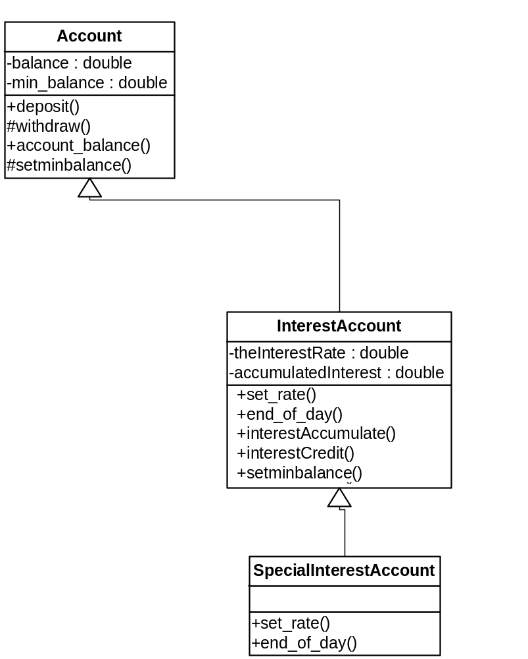
Special Interest Bearing Account(1)
SpecialInterestAccount extends InterestAccount
2 rates of interest - 1 for deposits of £1000+, a lower rate for those £1000
Method | Responsibility
Special_Interest_Account | Creates a special interest account. A single parameter indicates the opening balance.
set_rate | Sets the interest rate for all special interest bearing accounts
end_of_day | Performs end-of-day processing - calculates interest gained
Interest_Account
-the_interest_rate: double
-the_accumulated_interest
+set_rate()
+end_of_day()
#interest_accumulate()
+interest_credit()
+set_min_balance()
Special_Interest_Account
+set_rate()
+end_of_day()

Slide 41
Special Interest Bearing Account(2)
Constants class
Constructors
class SIA_Const
{ public static final double R1 = 0.00026116; //10%
public static final double R2 = 0.00028596; //11%
}
Calls superclass constructor
public Special_Interest_Account()
{
}
public Special_Interest_Account( final double initial )
{
super( initial ); //Constructor in Interest_Account
}

Slide 42
Special Interest Bearing Account(3)
Set_rate
end_of_day
public static void set_rate(final double ir1,
final double ir2){
the_interest_band_1 = ir1;
the_interest_band_2 = ir2;
}
public void end_of_day(){
double money = account_balance();
if ( money < 1000 )
interest_accumulate( account_balance() *
the_interest_band_1 );
else
interest_accumulate( account_balance() *
the_interest_band_2 );
}

Slide 43
The Object Class
All classes in Java are subclasses - even if they do not extend another class
Object is defined in the java.lang package
Object has many methods e.g.
  equals which return true if the object is equal to the object in the parameter list
    p1.equals(p2) is the same as p1==p2
  hashCode returns an integer which is used to locate an object
  toString returns the class name followed by an @ character and the object’s hash code (we often override this method)
  clone makes an identical copy of an object
  …, etc.

Slide 44
Abstract Classes
Suppose we want a general class to create subclasses from
Abstract Classes are those which cannot be directly constructed using new
  Typically - one or more methods have not been implemented
  Has no meaningful independent existence
Example
statement is left undefined - as it is different for each type of account
abstract class Abstract_Account
{
// data and methods as before in Account
abstract public String statement();
}

Slide 45
Abstract Classes (2)
class Normal_Account extends Abstract_Account
{
private String the_name = "";
Normal_Account( String name )
{ the_name = name;
}
public String statement()
{ return the_name + " balance is " + account_balance();
}
The inherited abstract
method statement()
must be implemented here –
and it has been!
Pure abstract class = one where all methods are abstract
abstract class Pure_Abstract_Account
{ abstract public double account_balance();
abstract public void deposit( final double money);
abstract public double withdraw( final double money );
}

Slide 46
Multiple Inheritance
where a class inherits from more than 1 class
Java does not allow this, but interfaces allow a workaround
Example of multiple inheritance
  A school database system has Teacher and Parent classes
  ParentTeacher extends both Teacher and Parent
Parent
Teacher
ParentTeacher

Slide 47
Multiple Inheritance (1)
class Parent
{ private String parentName;
public void setParentName(final String pname)
{ parentName = pname;
}
public String getParentName()
{return parentName;
}
}
interface TeacherInterface
{
public void setTeacherName(final String pname);
public String getTeacherName();
}

Slide 48
Multiple Inheritance (2)
class Teacher implements TeacherInterface
{ private String teacherName;
public void setTeacherName(final String pname)
{ teacherName= pname;
}
public String getTeacherName()
{ return teacherName;
}
}

Slide 49
Multiple Inheritance (3)
class ParentTeacher extends Parent
implements TeacherInterface
{ private String teacherName="";
public void setTeacherName(final String pname)
{ teacherName = pname;
}
public String getTeacherName()
{ return teacherName;
}
}

Slide 50
Multiple Inheritance (4)
class TestSchool{
public static void main(String args[]){
Teacher teacher1 = new Teacher();
Parent parent1 = new Parent();
ParentTeacher pt1 = new ParentTeacher();
teacher1.setTeacherName(“Fred");
parent1.setParentName("Bill");
pt1.setTeacherName(“Miss Jennifer Teacher");
pt1.setParentName("Jenny");
System.out.println("Teacher = " +
teacher1.getTeacherName());
System.out.println("Parent = " +
parent1.getParentName());
System.out.println("Parent Teacher = "
+ pt1.getTeacherName());
System.out.println("Parent Teacher = "
+ pt1.getParentName());
}
}

Slide 51
Multiple Inheritance (5)
IntAccount
ChqAccount
IntChqAccount
class IntAccount
{ data + methods
}
class ChqAccount implements ChqAccountInterface
{data + details of interface methods
}
interface ChqAccountInterface
{… data + method signatures
}
class IntChqAccount extends IntAccount implemenents
ChqAccountInterface
{… data + details of interface methods + own methods
}

Slide 52
Aggregation Association
objects/classes can be made up of other objects/classes.
= aggregation.
E.g. BOOK object may contain several objects, including: COVER, TABLE OF CONTENTS, CHAPTER, and INDEX objects.
  The CHAPTER object contains PAGE objects, which in turn contain PARAGRAPH objects, which in turn contain WORD objects, and so forth.
By identifying aggregation relationships we can partition a very complex object and assign behaviours and attributes to the individual objects within it.
Multiplicity is also specified for aggregate relationships

Slide 53
Aggregation Association
Book
Cover
Table of
Chapter
Index
Contents
Page
Paragraph
Word

Slide 54
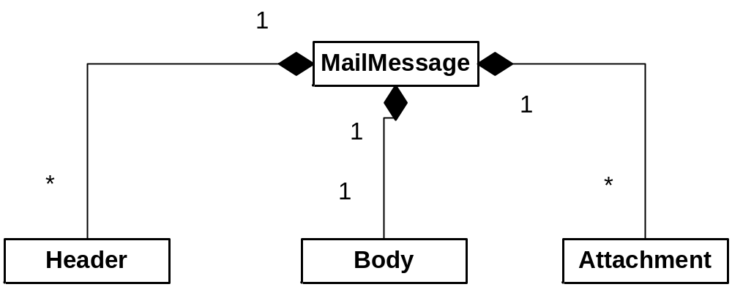
Composition Aggregation Example

Slide 55
Composition Aggregation
The ‘whole’ owns the instances of the parts
Destroy whole - part destroyed too
Composition Aggregation forms a tree structure.
Aircraft
1+
2
Engine
Wing
Fuselage
A single part cannot belong to
more than one whole
2+
Door
Landing
Gear

Slide 56
Shared Aggregation
With ‘Shared Aggregation’ the parts
can be associated with many wholes.
To use the example of staff recruitment, a candidate may be associated with an ‘applicants’ whole and at the same time be part of a ‘short-listed’ whole and eventually an ‘offer-made’ whole. Each of these wholes is acting as a collection class for ‘applicants’.
List
*
Open diamond symbol
for both shared and
‘normal’ aggregation
*
Applicant
‘Shared’ aggregation if
multiplicity > 1.

Slide 57
Don’t confuse aggregation and inheritance
Aggregation relates to Instances
Inheritance relates to Classes
1
Fuselage
1+
Plane
Engine
2
Wing
Commercial
Private
Military

Slide 58
Types of Object
Entity Objects = persistent information tracked by the system e.g. Year, Month, Day
Boundary Objects = interactions between the actors and the system e.g. Button, LCD Display
Control Objects = realising use cases e.g. ChangeDateControl

Slide 59
Example - Problem Statement for ATM
Design the software to support a computerised banking network including both human cashiers and automated teller machines (ATMs) to be shared by a consortium of banks. Each bank provides its own computer to maintain its own accounts and process transactions against them. Cashier stations are owned by individual banks and communicate directly with their own bank computers. Human cashiers enter account and transaction data. ATM’s communicate with a central computer which clears transactions with the appropriate banks. an ATM accepts a cash card, interacts with the user, communicates with the central system to carry out the transaction, dispenses cash and prints receipts. The system requires appropriate record keeping and security provisions. The system must handle concurrent accesses to the same account correctly. The banks will provide their own software for their their own computers; you are to design the software for the ATM’s and the network. The cost of the shared system will be apportioned to the banks according to the number of customers with cash cards.
Ref: Raumbaugh et al. Object Oriented Modeling and Design, Prentice Hall, 1991.

Slide 60
Identifying Entity Objects
Abbott’s* mapping scheme
  Proper noun ⇒ instance e.g. “Alice”
  Common Noun ⇒ class e.g. Field Officer, Incident,…
  Doing Verb ⇒ Operation e.g. Create, submit, …
  Being Verb ⇒ Inheritance e.g. is a, is a kind of, is one of…
  Having Verb ⇒ Aggregation e.g. Has, consists, includes …
  Modal verb ⇒ Constraints e.g. must be
  Adjective ⇒ Attribute e.g. Incident description, location,…
BUT English isn’t quite so straightforward
  For class identification, eliminate the
    redundant
    irrelevant – details unrelated to the problem
    vague - ill-defined, very broad concepts
    attributes - things that describe an object (but may be attributes of a class)
    operations - things that manipulate objects (but may be method calls)
    implementation constructs
*Russell J. Abbott (Computer Science, California State University). 1983.
Program design by informal English descriptions. Commun. ACM 26, 11 (November 1983), 882-894.

Slide 61
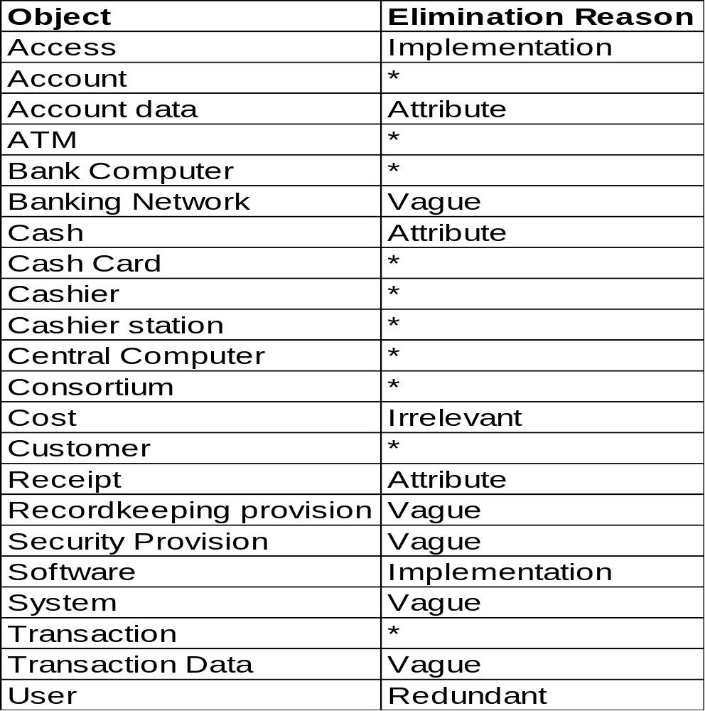
Object Modeling - Keeping the right classes
KEEP:
Account,
ATM,
Bank,
Bank Computer,
Cash Cards,
Cashier,
Cashier Station,
Central Computer, Consortium, Customer,
Transaction

Slide 62
ATM - Identify Associations
  Associations correspond to verbs in the problem statement
  Association = any dependency between two classes
  from verb phrases involving identified classes
    consortium shares ATMs
    bank provides bank computer
    bank computer maintains accounts etc...
  or from implicit verb phrases
    consortium consists of banks
    bank holds account etc...
  or from knowledge of the problem domain
    cash card accesses accounts
    bank employs cashiers

Slide 63
Initial Class Diagram
0..*
Has
2..*
Customer
Consortium
Consists of
Bank
Holds
0..*
Account
Concerns
Owns
Owns
Accesses
Owns
0..*
Employs
Central Computer
0..*
Bank Computer
0..*
Cashier
Concerns
Communicates
Communicates
Enters
with
with
0..*
0..*
0..*
Has
0..*
Entered On
Communicates
Cashier Station
Cashier transaction
with
0..*
0..*
0..*
ATM
Entered On
0..*
Cash Card
0..*
Remote transaction
Authorised by

Slide 64
Identifying Attributes (…and qualified associations)
0..*
0..1
Has
Customer
Consortium
Bank
account
code
0..1
Account
bank code
Consists of
Holds
balance
name
credit limit
bank
code
station
code
type
employee code
Accesses
Owns
Owns
Concerns
0..1
Owns
Employs
Bank Computer
Cashier
Central Computer
bank code
0..1
name
0..1
station
code
Communicates
Enters
Concerns
station code
with
Communicates
0..1
0..*
0..*
Has
with
0..1
Cashier Station
Cashier transaction
Communicates
0..*
with
amount
Entered On
date-time
0..1
kind
0..*
0..*
ATM
Entered On
0..*
Remote transaction
cash on hand
0..*
dispensed
amount
0..*
Cash Card
date-time
Authorised by
password
kind

Slide 65
Class Relationship Modelling – Main Features
Class
Association
Inheritance
Aggregation
Library Item
no_of_copies
1
0..*
shelf_no
borrows
status
User
title
address
issue
member_no
return
name
shelve
subscribe
unsubscribe
External Reader
Borrower
Recorded Media
ext_library_name
items_borrowed
Book
CAL Package
maximum_loans
author
distributor
isbn
Course Text
pub_date
publisher

Slide 66
Software Engineering
Chapter 6: Software Design
Unified Modelling Language
Class Diagrams
Learning Outcomes
  Be able to identify classes from a problem description
  Be able to create class diagrams from a description of a problem
  Understand and be able to apply the constructs of a class diagrams
Text: Priestley Chapter 8
Bruegge & Dutoit, Chapter 5

